Slide 1
Checking understanding of place value in integers
Place value

Slide 2
how to use Oak lessons

Slide 3
I can use my understanding of place value to create numbers that meet certain conditions.

Slide 4

Checking understanding of place value in integers
Reviewing integer place value
Using place value

Slide 5
A digit is one of the symbols of a number system. In our number system we use the digits 0, 1, 2, 3, 4, 5, 6, 7, 8 and 9.
An integer is any positive or negative whole number or zero. E.g. -2, 0, 153 are all examples of integers.

Slide 6
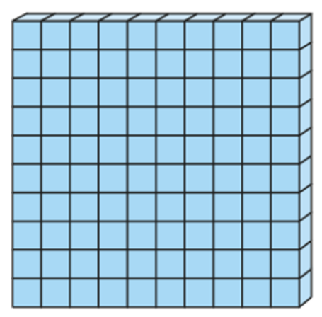
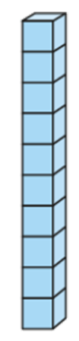

Reviewing integer place value
What is the same and what is different about these two integers?
123
321

Slide 7
Reviewing integer place value
Show this integer in a place value chart.
Show this integer in a place value chart.
123
321
H | T | O
H | T | O

Slide 8
Reviewing integer place value
Here is thirty-two million, nine hundred and ten thousand, three hundred and seventy four.
HM | TM | M | HTh | TTh | Th | H | T | O
You write this as 32 910 374

Slide 9


Reviewing integer place value
Which is the correct way to write the integer that is represented in this place value chart?
HM | TM | M | HTh | TTh | Th | H | T | O
a
145 307
b
14 537
c
000 145 307

Slide 10
Reviewing integer place value
To find the value of a digit in an integer you can use a place value chart.
What is the value of the digit 8 in the integer 6 180 254?
HM | TM | M | HTh | TTh | Th | H | T | O
 |  | 6 | 1 | 8 | 0 | 2 | 5 | 4
HM | TM | M | HTh | TTh | Th | H | T | O
 |  | 6 | 1 | 8 | 0 | 2 | 5 | 4
The digit 8 is in the ten thousands place so its value is 80 000

Slide 11
Reviewing integer place value
What is the value of the digit 3 in the integer 20 653 409?
HM | TM | M | HTh | TTh | Th | H | T | O
3
thousands
3000

Slide 12
Reviewing integer place value
You can partition an integer using place value to show the value of the digits.
681
95
600
80
1
90
5

Slide 13
Reviewing integer place value
You can partition an integer using place value to show the value of the digits.
5703
5000
700
3

Slide 14
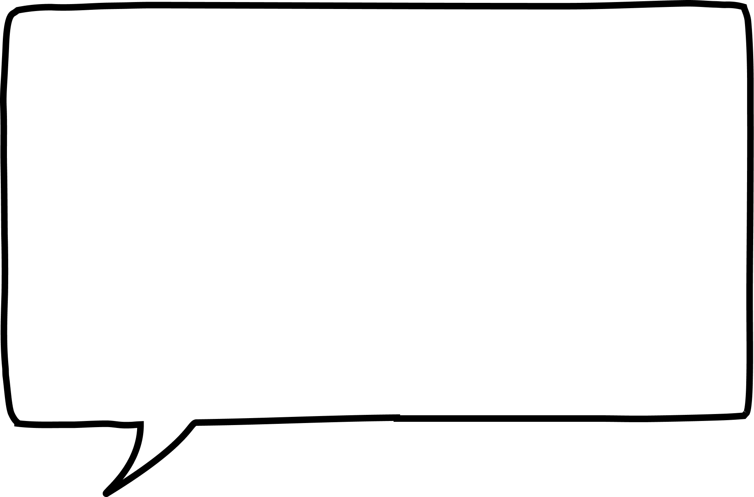
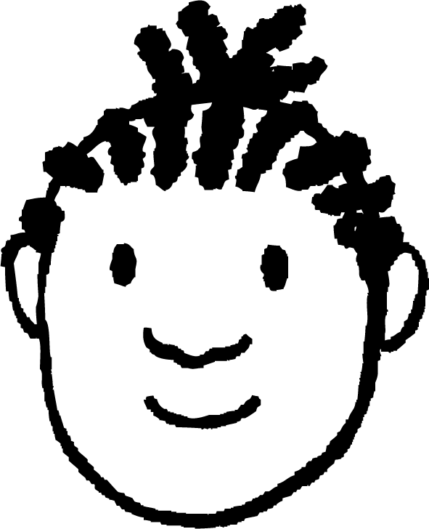
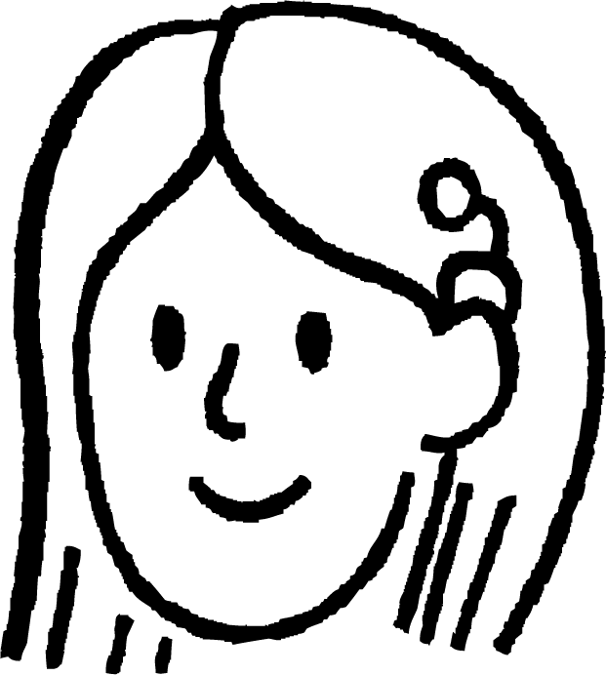
Reviewing integer place value
Jacob and Sofia are looking at the integer 107.
Who is correct?
I have partitioned 107 like this:
I have partitioned 107 like this:
107
107
Jacob
Sofia
1
0
7
100
7

Slide 15
Reviewing integer place value
1) Write down the value of the digit 8 in each integer:
285
2805
20 805 205
5 000 308
58 353
2) Write the integer 20 805 205 in words.
3) Write these using digits.
You could use a place value chart to help.
Five hundred and sixteen thousand, two hundred and twelve.
Forty-two million, ninety-three thousand, seven hundred and one.

Slide 16
Reviewing integer place value
4) Give an example of an integer which:
a) is greater than 1000
b) and is less than 2000
c) and has a 5 in the tens place
d) and contains the digits 3 and 9

Slide 17
Reviewing integer place value
1) Write down the value of the digit 8 in each integer:
285 80
2805 800
20 805 205 800 000
5 000 308 8
58 353 8000
2) Write the integer 20 805 205 in words. Twenty million, eight hundred and five thousand, two hundred and five
3) Write these using digits.
Five hundred and sixteen thousand, two hundred and twelve.
Forty-two million, ninety-three thousand, seven hundred and one.
516 212
42 093 701

Slide 18
Reviewing integer place value
4) Give an example of an integer which:
a) is greater than 1000 e.g. 35 678
b) and is less than 2000 e.g. 1678
c) and has a 5 in the tens place e.g. 1658
d) and contains the digits 3 and 9 1359 or 1953

Slide 19
Checking understanding of place value in integers
Reviewing integer place value
Using place value

Slide 20
Using place value
Where you place a digit in an integer affects its overall value.
4
2
9
What is the largest 2-digit number you can make from these cards?
9
4

Slide 21
Using place value
4
2
9
What is the largest 2-digit odd integer you can make from these cards?
4
9

Slide 22
Using place value
Here are a different set of digit cards.
7
3
0
8
What is the smallest 4-digit number you can make from these cards?
0
3
0
7
8

Slide 23
Using place value
Using these digit cards what is the smallest 3-digit integer you can make?
7
0
5
570
507
Although this uses 3 digits this is the integer 57 which is a 2-digit integer.
057

Slide 24
Using place value
1) Use the digit cards to create:
a) the largest possible 5-digit integer
b) the smallest possible 5-digit integer
c) the 5-digit integer that is closest to 90 000
d) the smallest possible 5-digit even integer
9
7
6
0
8

Slide 25
Using place value
2) Using these cards, how many different 5-digit integers can you create between 50 000 and 70 000?
How do you know?
9
7
6
0
8

Slide 26
Using place value
1) Use the digit cards to create:
a) the largest possible 5-digit integer 98 760
b) the smallest possible 5-digit integer 60 789
c) the 5-digit integer that is closest to 90 000 89 760
d) the smallest possible 5-digit even integer 60 798
9
7
6
0
8

Slide 27
Using place value
2) Using these cards, how many different 5-digit integers can you create between 50 000 and 70 000?
How do you know?
9
7
6
0
8
60 789, 60 798, 60 879, 60 897, 60 978,
60 987, 67 089, 67 098, 67 809, 67 890,
67 908, 67 980, 68 079, 68 097, 68 709,
68 790, 68 907, 68 970, 69 078, 69 087,
69 708, 69 780, 69 807, 69 870
I know the only digit I can start with is the 6.
I then used the other digits, writing the integers in ascending order.

Slide 28
Checking understanding of place value in integers
Digits can have different values depending on their place value.
The place value of a digit affects the overall value of an integer.

Slide 29

© Oak National Academy 2023.
Produced in partnership with Mathematics in Education and Industry.
Licensed on the Open Government Licence v3.0, except where otherwise stated. See Oak terms and conditions.

